Slide 1

Flight Fare Data Analysis
Arnab Samanta
22-07-2024

Slide 2

OUTLINE
Introduction
Methodology
Results
Visualization-charts
Findings
Conclusion

Slide 3

Introduction
About: Flight Fare Data Analysis
Objective:
Factors that impact flight ticket price
Check if specific city pairs with consistently high or low prices
Check is there any optimal time for ticket booking.

Slide 4

Methodology
Data Collection
Link: https://drive.google.com/file/d/1n9FqH3D1-nvviwvktEZeW4cgEPacGuRe/view?usp=drive_link
Data Pre-processing
Data Profiling
Data Cleaning
Data Consistency
Data Formatting
Outlier Detection & Removal
Exploratory Data Analysis

Slide 5
Results
Visualization (charts)
Distribution of flight price - page 6
Number of flights and average flight price per airline - page 7
Average flight duration per airline- page 8
Number of flights and flight price per class - page 9
Number of stops per flight and average flight price per number of stops - page 10
Price change with change in source to destination - page 11
Departure time, arrival time v/s flight price - page 12
Days left for departure v/s flight price- page13
Flight duration v/s price- page14

Slide 6
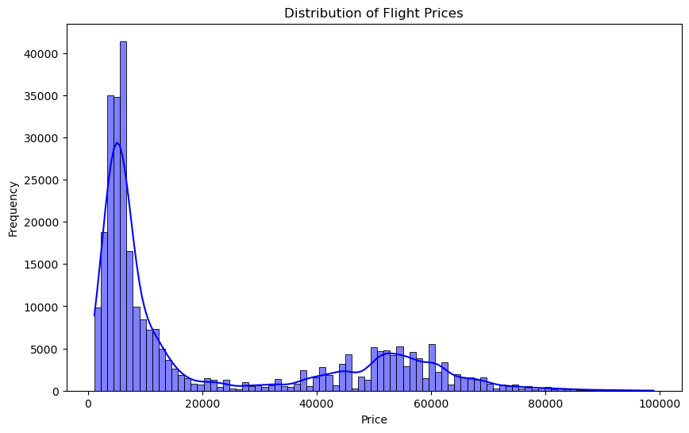
The distribution of flight prices is heavily right-skewed, indicating that while most flights are priced lower, there are a few flights with significantly higher prices.

Slide 7
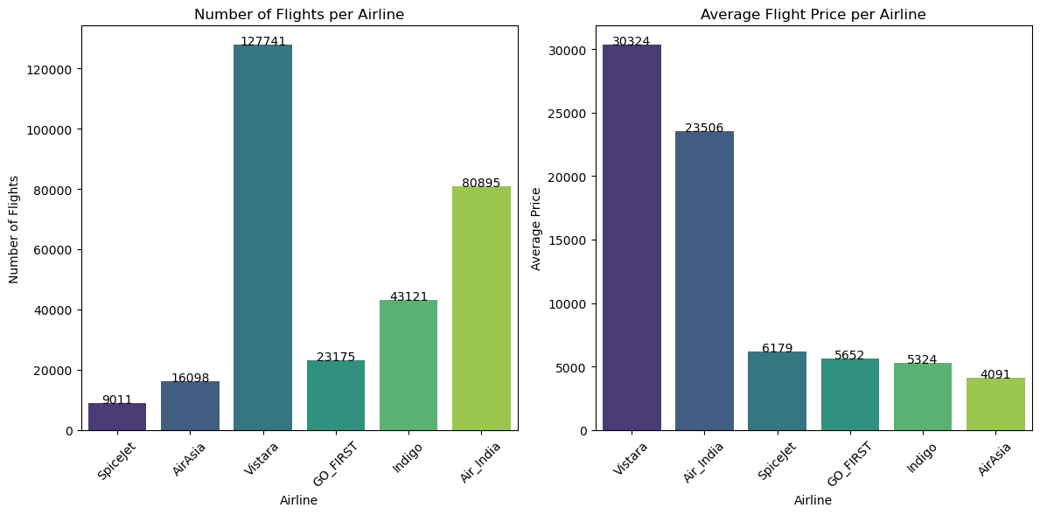
Vistara has the highest number of flights at 127,741, making it the most frequent airline in the dataset. Vistara and Air India have the highest average flight prices at 30,324 and 23,506 units respectively, suggesting a focus on premium pricing strategies.

Slide 8
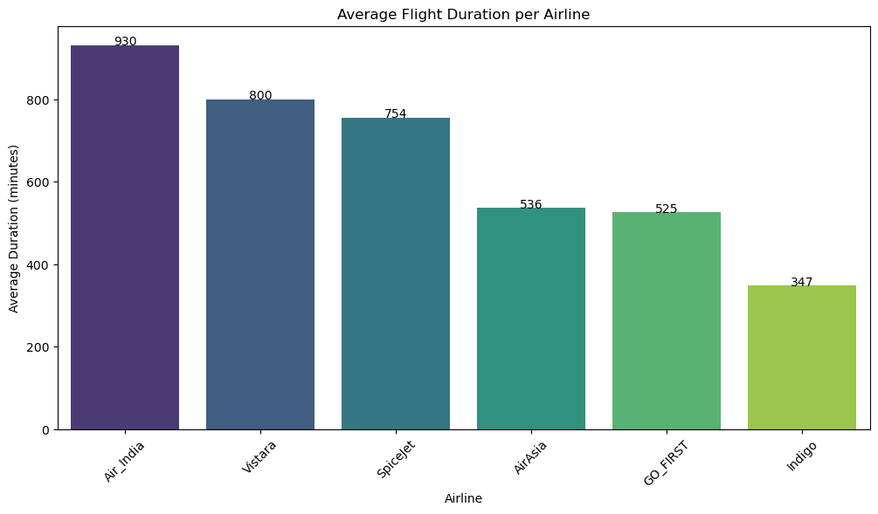
Some airlines have significantly longer flights (e.g., Air_India with 930 minutes) while others are much shorter (e.g., GO-FIRST with 525 and Indigo with 347 minutes).

Slide 9
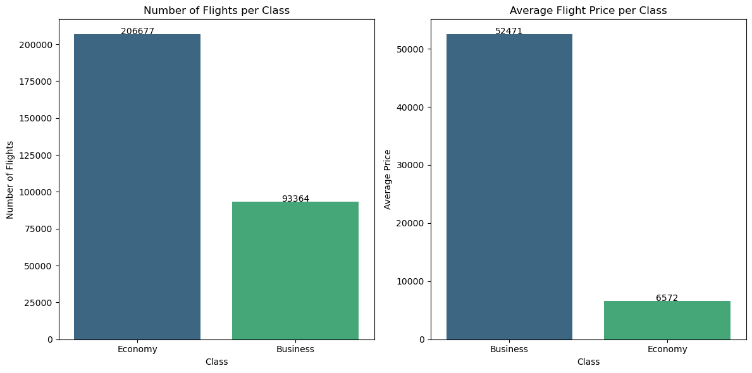
Economy class has a significantly higher number of flights (206,677) compared to Business class (93,364).But Business class has a higher average price (52,471) than Economy class (6572).

Slide 10
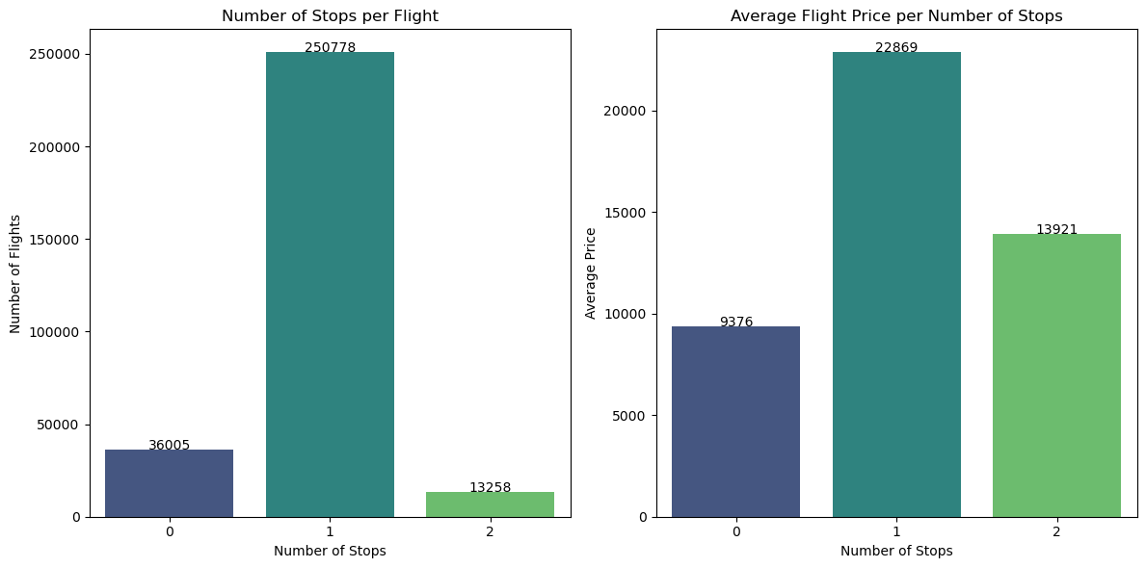
Most flights have either 1 stop or no stops. A smaller number of flights have 2 stops. Flights with 1 stop tend to be the most expensive .Flights with 2 stops are cheaper than one-stop flights but still pricier than direct flights.

Slide 11
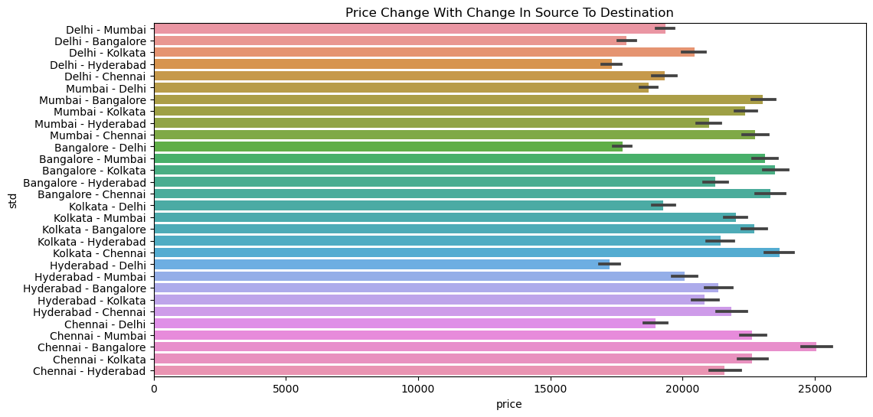
Chennai to Bangalore flights are most expensive flights compare to other flights

Slide 12
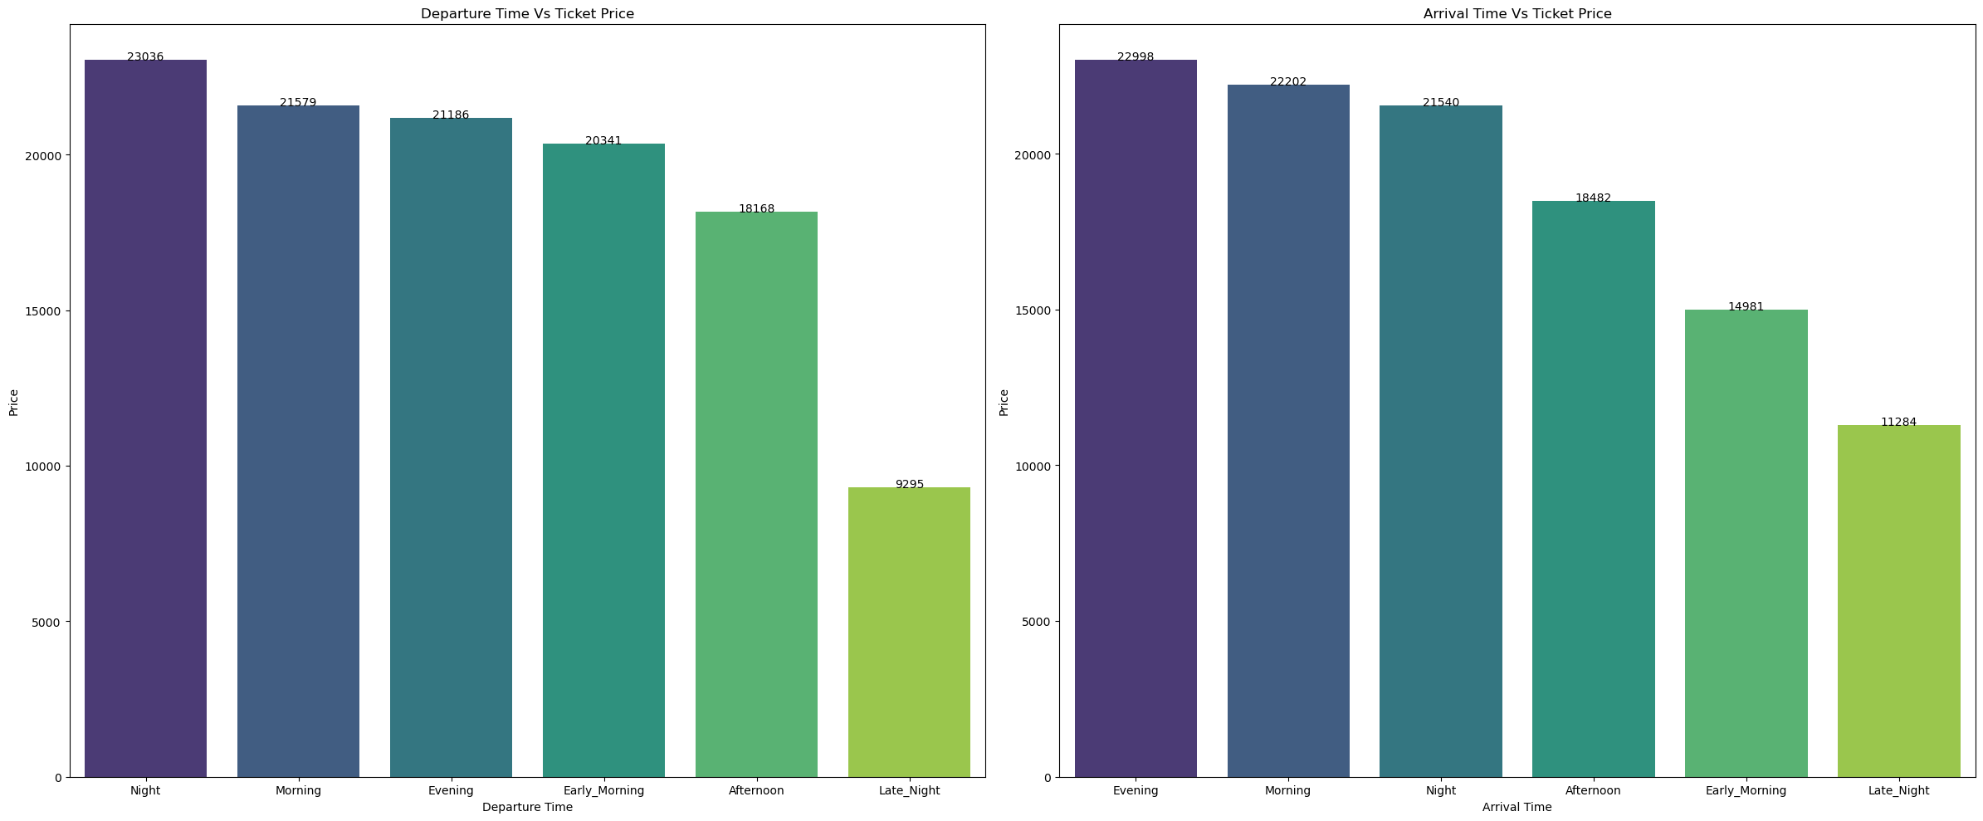
The graph comparing departure times with total prices shows that night flights tend to be the most expensive, followed by morning ,evening , early morning flights .Afternoon and late night flights have a lower price.
The graph comparing arrival times with total prices reveals evening flights are associated with higher prices, followed by morning arrivals. Late night arrivals are the least expensive.

Slide 13
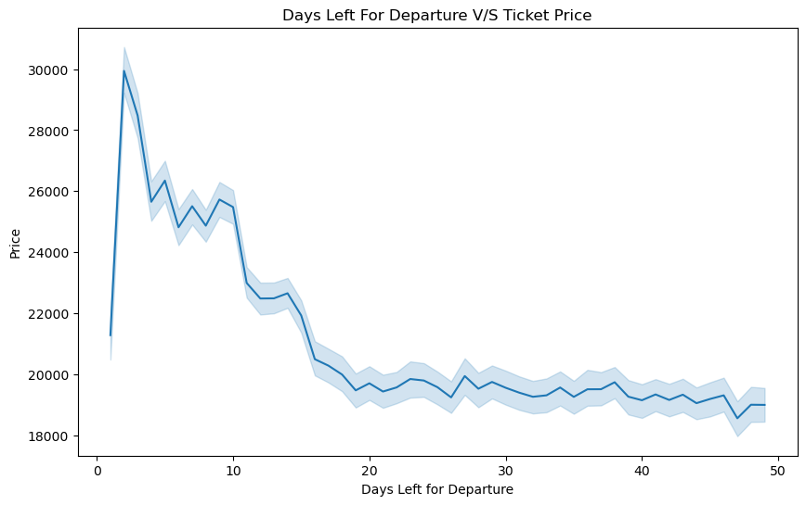
When there are many days left before departure, prices are low in that time. However, prices are increases as the departure date gets very close.

Slide 14
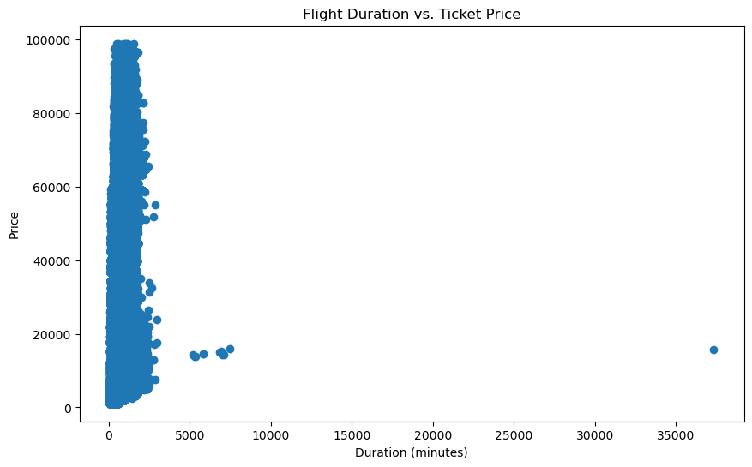
Most flights have shorter durations, clustered near the lower left corner. Ticket prices tend to be lower for shorter
flights. A few outliers have longer durations and higher prices.

Slide 15
Findings
The distribution of flight prices is heavily right-skewed, indicating that while most flights are priced lower, there are a few flights with significantly higher prices.
Vistara has the highest number of flights at 127,741, making it the most frequent airline in the dataset. Vistara and Air India have the highest average flight prices at 30,324 and 23,506 units respectively, suggesting a focus on premium pricing strategies.
Some airlines have significantly longer flights (e.g., Air _ India with 930 minutes) while others are much shorter (e.g., GO-FIRST with 525 and Indigo with 347 minutes).
Economy class has a significantly higher number of flights (206,677) compared to Business class (93,364).But Business class has a higher average price (52,471) than Economy class (6572).
Most flights have either 1 stop or no stops. A smaller number of flights have 2 stops. Flights with 1 stop tend to be the most expensive .Flights with 2 stops are cheaper than one-stop flights but still pricier than direct flights.
Chennai to Bangalore flights are most expensive flights compare to other source city to destination city flights.
The graph comparing departure times with total prices shows that night flights tend to be the most expensive, followed by morning ,evening , early morning flights .Afternoon and late night flights have a lower price . The graph comparing arrival times with total prices reveals evening flights are associated with higher prices, followed by morning arrivals. Late night arrivals are the least expensive.
When there are many days left before departure, prices are low in that time. However, prices are increases as the departure date gets very close.
Most flights have shorter durations, clustered near the lower left corner. Ticket prices tend to be lower for shorter flights. A few outliers have longer durations and higher prices.

Slide 16
Conclusion
Flight prices vary widely based on airlines and flight characteristics. Vistara and Air India offer more premium options with higher average prices. Economy class is more budget-friendly but has more availability compared to pricier Business class flights. Direct flights and those with fewer stops are generally cheaper than multi-stop options. Booking earlier usually means lower prices, while last-minute bookings can be more expensive. Consider flight timings too—afternoon, early morning and late night flights are cheaper. Shorter flights are generally cheaper, but keep an eye out for occasional higher-priced longer flights.

